Slide 1

Dynamics of an Epidemic Network Model
Hitesh Bahar
Matthew Mietchen

Slide 2
Background (Matt)
Antimicrobial Resistance (AMR) is a major challenge
i.e. MRSA (methicillin resistant staphylococcus aureus)
Disease transmission in hospitals are difficult to study
Disease models help to understand transmission dynamics
Pathogen colonization vs infection
Intra-hospital vs inter-hospital transmission
Pathogen transmission within a hospital is extremely complicated
Creates a meta-population structure

Slide 3
SIS model (Intra-hospital) (Matt)
Mrsa Transmission Stochastic Compartmental model
S (susceptible) – uncolonized patients
I (Infected) – colonized patients
Model assumptions
Homogenous mixing (mass action) of patients
Patients are only colonized by other patients
Colonized patients are not treated (natural de-colonization only)
Closed hospital model
Model Analysis & Simulations
R package - Gillespie's Stochastic Simulation Algorithm (SSA)

Slide 4






SIS model (Intra-hospital) (Matt)
$$\text{μ}$$
Parameters
𝛃 (beta) – Colonization Rate
𝛄 (gamma) – Decolonization rate
𝛉 (theta) – Death or Discharge
𝛍 (mu) – Admissions who are colonized
S _{𝒊}
$$θ$$
$$\text{β}$$
$$\text{γ}$$
I _{𝒊}
$$θ$$
Patient Transfers
$$\text{μ}$$

Slide 5
SIS model (Intra-hospital) (Matt)
Model Simulations using GillespieSSA (R package software)
100 patients (99 susceptible / 1 infected)
100 simulations (500 time steps per simulation)
Studied a range of patient colonization rates (R₀)

Slide 6
SIS Model Results (Matt)

Slide 7
SIS inter-hospital network model (Matt)
Main Objective:
Implement sis network network model for hospital patient transfers
Study a range of the colonization rates (R0)
Compare the disease spread across different Random network structures
Erdos-Renyi
Barabasi (Preferential Attachment)
Watts & Strogatz (Small World)
Network Parameters
100 nodes (hospitals)
Equal probability of Patient Transfer
Hospitals “infect” Hospitals with similar probabilities as patients to patients

Slide 8
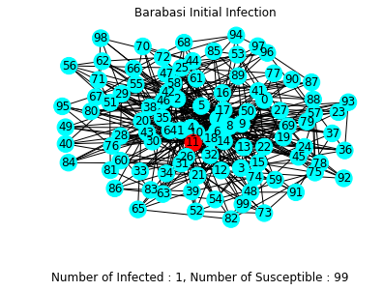
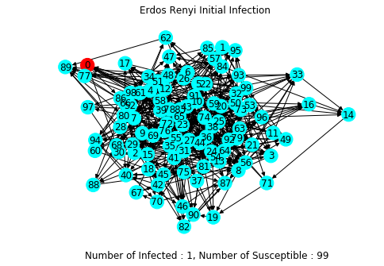
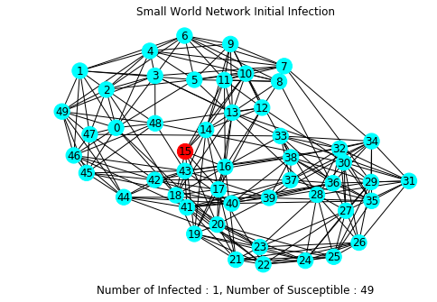
Initial Infection Networks (Hitesh)

Slide 9
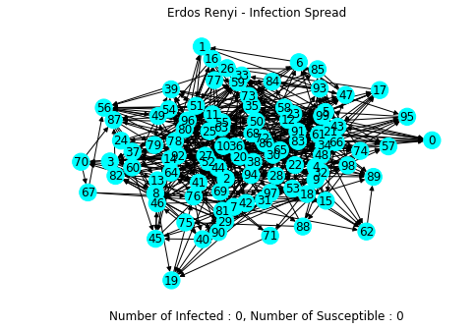
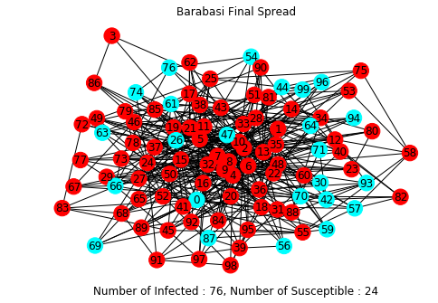
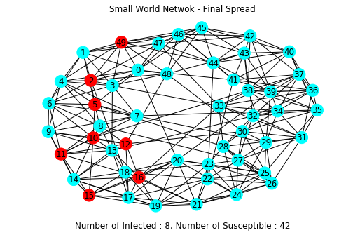
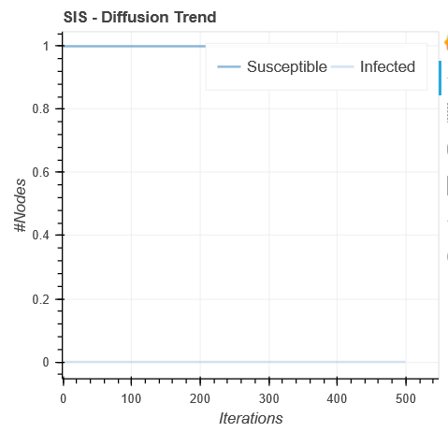
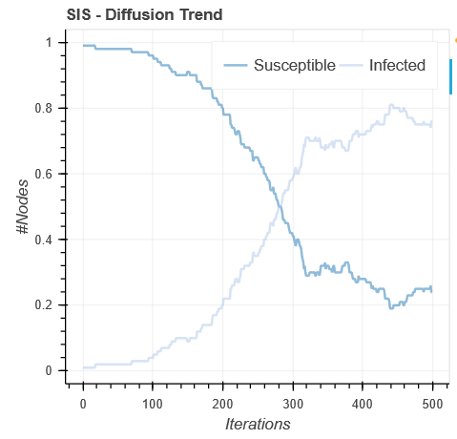
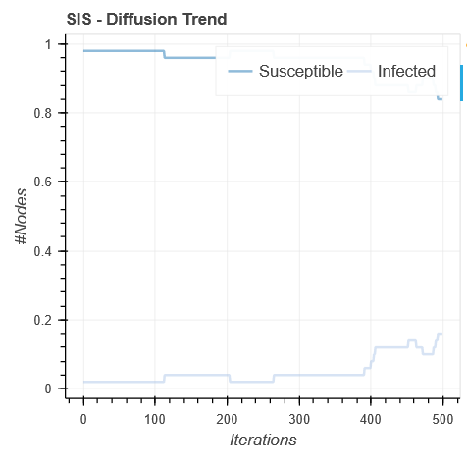
Network Comparison (R₀ = 0.8)

Slide 10
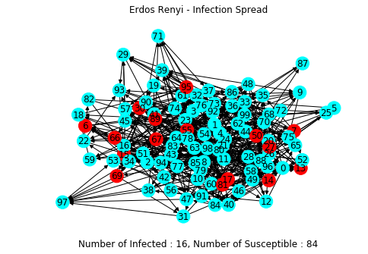
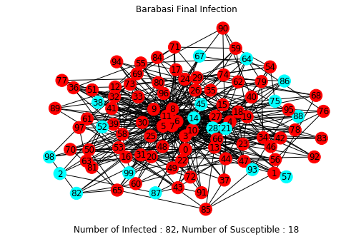
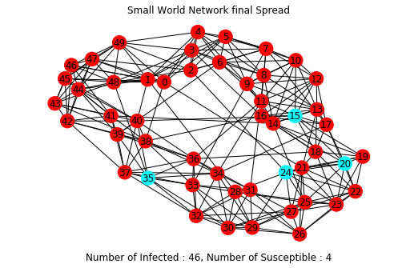
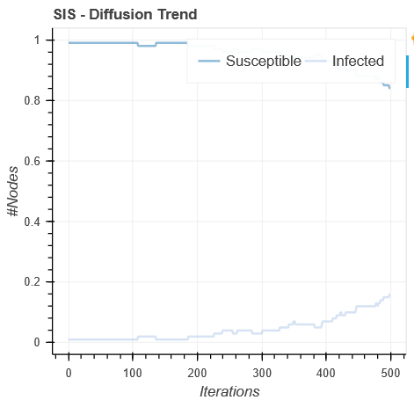
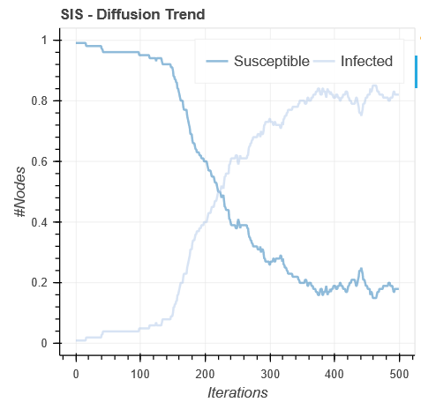
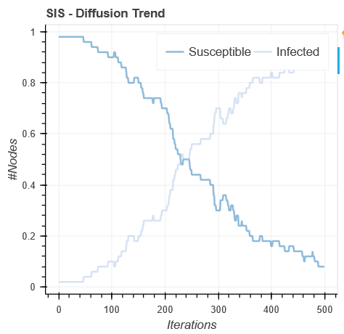
Network Comparison (R₀ = 1.0)

Slide 11
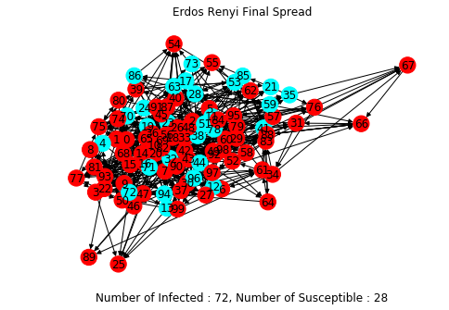
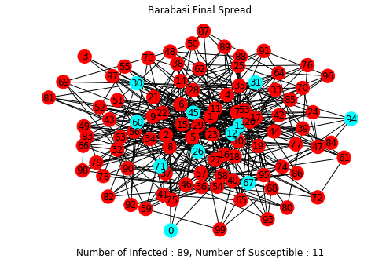
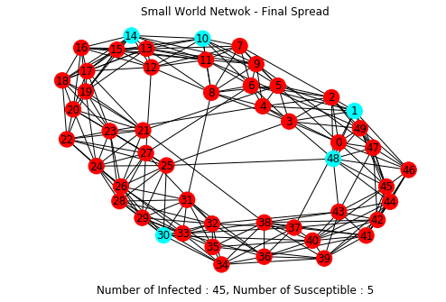
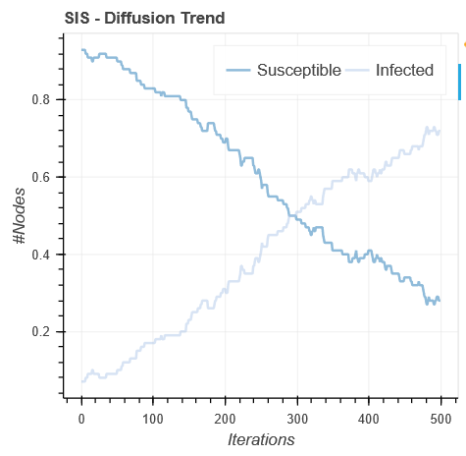
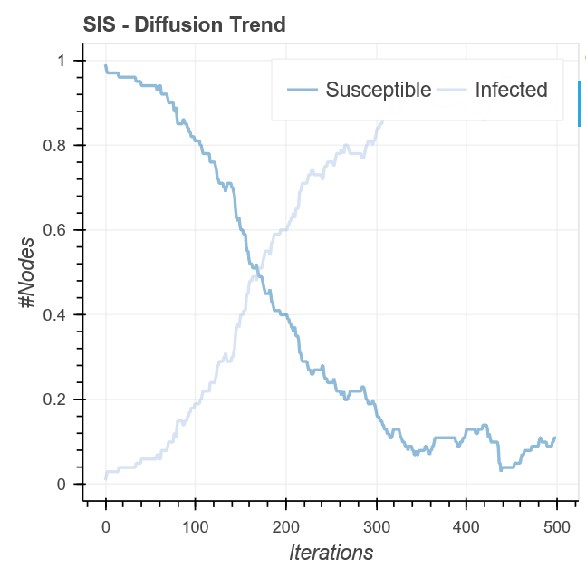
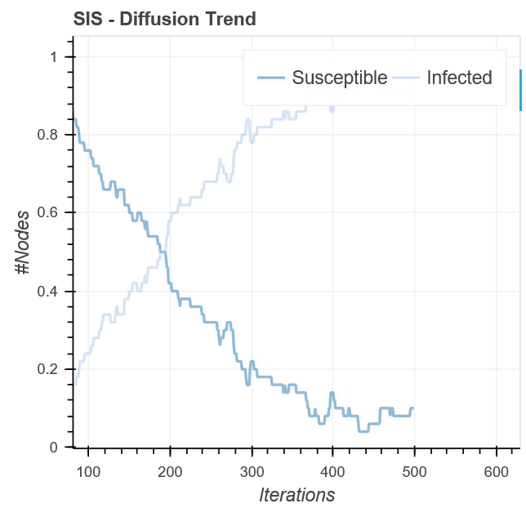
Network Comparison (R₀ = 1.2)

Slide 12
Meta-population network model (Matt)
Main Question:
Does patient transfers between hospitals have an effect on the Spread of MRSA
Metapopulation model structure
Infection spreads within Hospitals
100 hospitals w/ SIS model per hospital
Patient Transfers link the hospitals
probability of a colonized patient being transferred (per day)

Slide 13
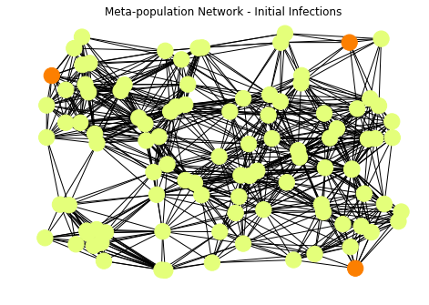
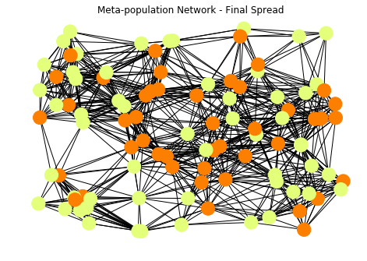
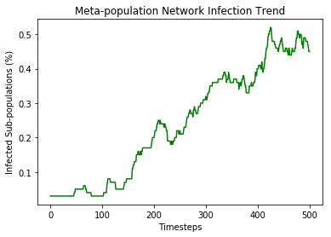
Meta-population results (both)

Slide 14
Discussion & challenges (both)
Discussion
Challenges
Recoding graphs not based on Euclidean distance
Implement the SIS model into each patch or node in the network

Slide 15
Next steps / future work (both)

